Slide 1
Recommender Systems

Slide 2
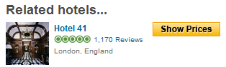
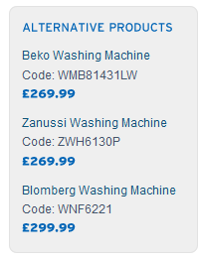
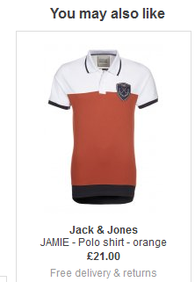

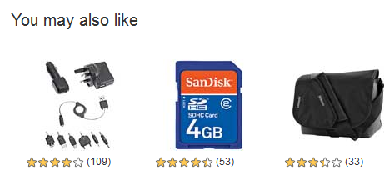
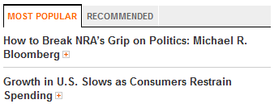
Recommender Systems
Application areas

Slide 3
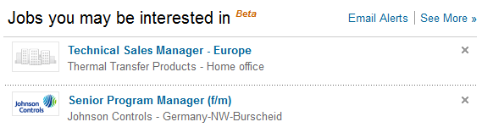
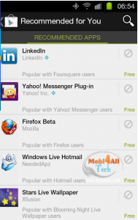
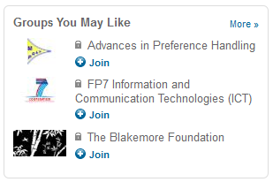
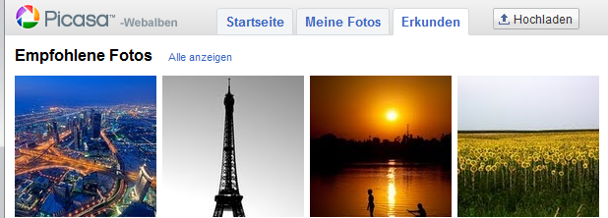
In the Social Web

Slide 4

Introduction

Slide 5
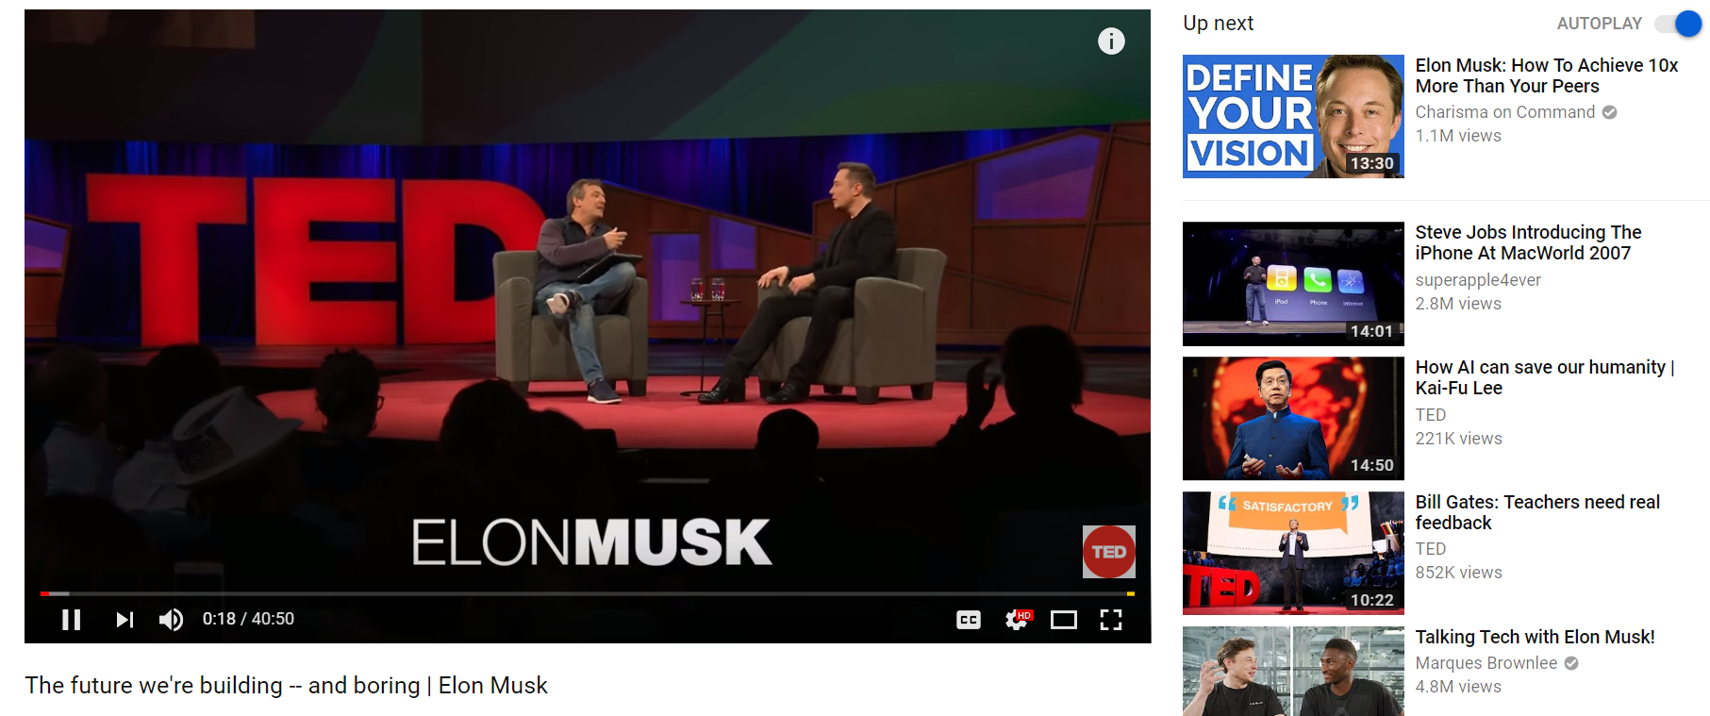
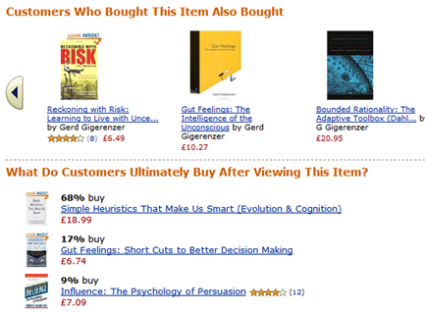
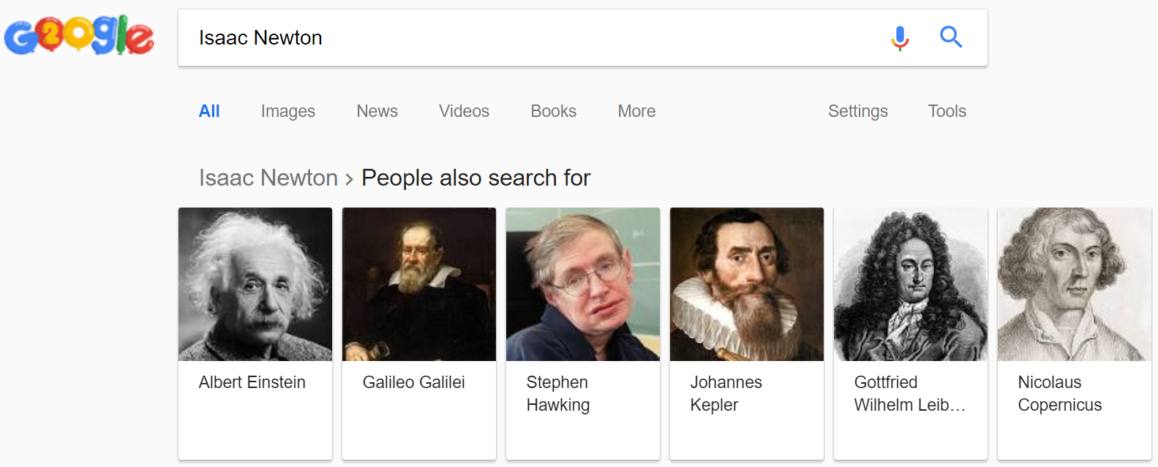
Recommender Systems
A recommender system (RS) helps users that have no sufficient competence or time to evaluate the, potentially overwhelming, number of alternatives offered by a web site.
In their simplest form, RSs recommend to their users personalized and ranked lists of items

Slide 6
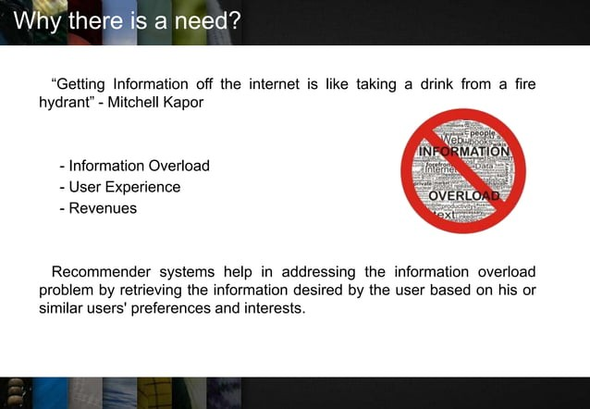

Slide 7
Why using Recommender Systems?
Value for the customer
Find things that are interesting
Narrow down the set of choices
Help me explore the space of options
Discover new things
Entertainment
…
Value for the provider
Additional and probably unique personalized service for the customer
Increase trust and customer loyalty
Increase sales, click trough rates, conversion etc.
Opportunities for promotion, persuasion
Obtain more knowledge about customers
…

Slide 8
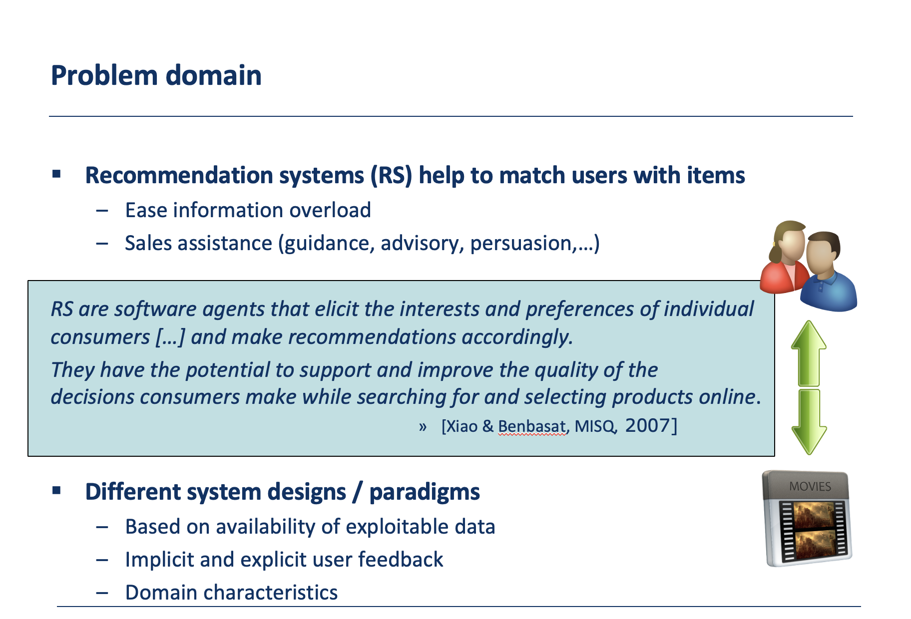

Slide 9




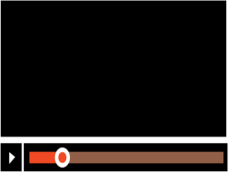

User feedback
Explicit feedback: Users indicate their preference for items
Ratings scales (1-5 stars, 1-10 stars)
Binary values (liked/disliked)
Implicit feedback: Users interact with items
Purchase history
Viewing duration
Click patterns

Slide 10
Implicit User Feedback:
Indirect Signals: Implicit feedback is derived from user actions or behavior that is not explicitly provided for the purpose of generating recommendations. These actions may include clicks, view time, purchase history, search queries, and mouse movements.
Advantages:
Abundant Data: Implicit feedback is often more abundant as it does not require users to explicitly rate or review items.
Non-Intrusive: Users do not need to take extra actions, making it a non-intrusive way to collect feedback.
Real-Time: Implicit feedback is often available in real-time, allowing for immediate updates to recommendations.

Slide 11
Challenges:
Ambiguity: The meaning of implicit actions can be ambiguous. For example, a click does not necessarily indicate a positive preference.
No Negative Feedback: Lack of interaction with an item does not necessarily mean a user dislikes it. It might be due to other factors like position on the page.
Cold Start: Implicit feedback can be less effective for new users or items because there may not be sufficient data for personalization.

Slide 12
Explicit User Feedback:
Direct Ratings or Reviews: Explicit feedback is information that users provide explicitly about items, such as ratings, reviews, likes, dislikes, and comments.
Advantages:
Clear User Preferences: Explicit feedback provides a clearer signal of user preferences. A 5-star rating or a positive review clearly indicates liking an item.
Mitigating Cold Start: Explicit feedback can help address the cold start problem by providing initial data for recommendations.

Slide 13
Challenges:
Sparse Data: Explicit feedback is often sparse, as users may not always provide ratings or reviews for items.
User Effort: Users need to actively provide feedback, which can be time-consuming and may lead to low participation.
Biased Data: Users who provide explicit feedback might not be representative of the entire user base, leading to bias in recommendations.

Slide 14
Recommender systems
RS seen as a function
Given:
User model (e.g. ratings, preferences, demographics, situational context)
Items (with or without description of item characteristics)
Find:
Relevance score. Used for ranking.
Finally:
Recommend items that are assumed to be relevant
But:
Remember that relevance might be context-dependent
Characteristics of the list itself might be important (diversity)

Slide 15
Real-world check
Myths from industry
Amazon.com generates X percent of their sales through the recommendation lists (30 < X < 70)
Netflix (DVD rental and movie streaming) generates X percent of their sales through the recommendation lists (30 < X < 70)
There must be some value in it
See recommendation of groups, jobs or people on LinkedIn
Friend recommendation and ad personalization on Facebook
Song recommendation at last.fm
News recommendation at Forbes.com (plus 37% CTR)
Academia
A few studies exist that show the effect
increased sales, changes in sales behavior

Slide 16
The Impact of RecSys
35% of the purchases on Amazon are the result of their recommender system, according to McKinsey.
During the Chinese global shopping festival of November 11, 2016, Alibaba achieved growth of up to 20% of their conversion rate using personalized landing pages, according to Alizila.
Recommendations are responsible for 70% of the time people spend watching videos on YouTube.
75% of what people are watching on Netflix comes from recommendations, according to McKinsey

Slide 17



Significant industrial & research interest in recommendation systems:
2 out of 3 watched hours come from recommendations
increases its watch times by 50% per year
35% of all sales are generated by recommendations
Notes:
Μεγάλες διεθνείς εταιρείες επικεντρώνονται στην έρευνα και ανάπτυξη τέτοιων συστημάτων συστάσεων, και η θετική επίδραση που έχουν είναι σημαντική. Συγκεκριμένα η Netflix αναφέρει ότι 2 από τις 3 ώρες περιεχομένου που παρακολουθούνται, έχουν προέλθει από προτάσεις, ενώ μέσω των προτάσεων η YouTube αυξάνει τους χρόνους παρακολούθησης κατά 50% κάθε χρόνο. Από την άλλη, η Amazon μια e-commerce υπηρεσία, αναφέρει ότι 1 στα 3 προϊόντα που αγοράζονται, προέρχονται από προτάσεις που έγιναν στους πελάτες.

Slide 18
1. Introduction
Dramatic increase of content-delivery services and multimedia content
Wide-range of choices and tight time constraints
Efficient mechanisms required for discovering preferred content
☞ Improvement of user satisfaction, decrease in churn rates
Recommendation systems (RS) address these problems
✓ Exploit information about user preferences
✓ Accurately & efficiently recommend the appropriate content
Notes:
Τα τελευταία χρόνια έχει παρατηρηθεί μια μεγάλη αύξηση σε υπηρεσίες παροχής περιεχομένου αλλά και του ίδιου του περιεχομένου που παρέχεται. Δεδομένου αυτού του μεγάλου εύρους επιλογών, απαιτούνται μηχανισμοί που θα βοηθήσουν τους χρήστες να ανακαλύψουν το περιεχόμενο που τους ενδιαφέρει. Έτσι θα ικανοποιηθούν περισσότερο, και η υπηρεσία θα καταφέρει να διατηρήσει και να αυξήσει το πελατολόγιο της.
Τα ΣΠ μπορούν να αντιμετωπίσουν αυτά τα προβλήματα, αξιοποιώντας πληροφορίες που αφορούν τις προτιμήσεις των χρηστών και με ακριβή και αποδοτικό τρόπο προτείνουν το κατάλληλο περιεχόμενο σε κάθε χρήστη.

Slide 19



The Rise of the Recommender System
*
*2018-Estimated
Notes:
While the term was coined in early 90s
It became popular in 1997 with the important special issue of RS by Paul Resnik in Communication of the ACM

Slide 20
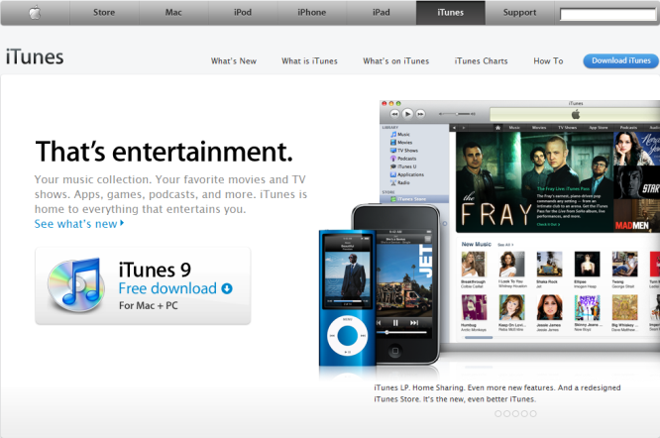

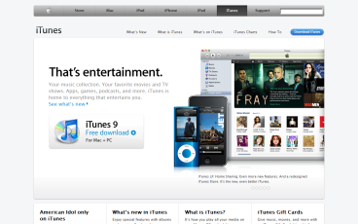
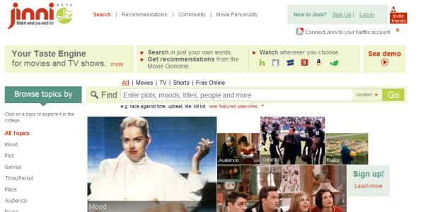
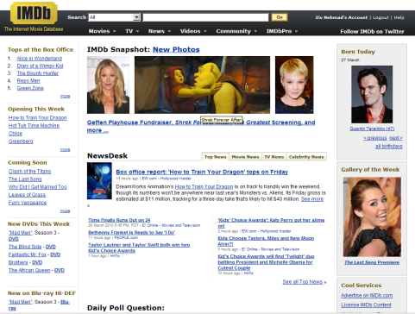


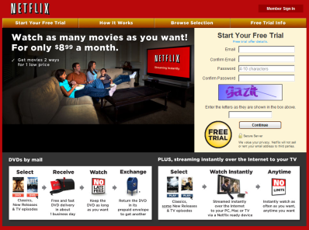
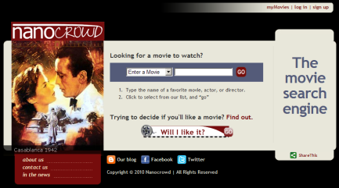
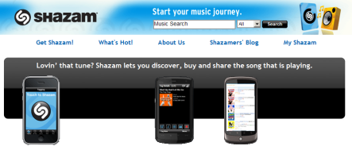
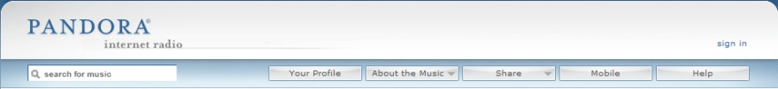

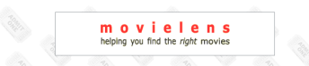


Recommendation Models
Model | Commonness | Used By:
 |  | Jinni | Taste Kid | Nanocrowd | Clerkdogs | Criticker | IMDb | Flixster | Movielens | Netflix | Shazam | Pandora | LastFM | YooChoose | Think Analytics | Itunes | Amazon
Collaborative Filtering |  | v |  |  |  | v | v | v | v | v | v |  | v | v | v | v | v
Content-Based Techniques |  | v | v | v | v |  | v |  | v |  |  | v | v | v | v |  | v
Knowledge-Based Techniques |  | v | v | v | v |  | v |  |  |  |  | v |  |  | v
Stereotype-Based Recommender Systems |  | v | v | v | v |  | v |  |  |  |  |  |  | v | v
Ontologies and Semantic Web Technologies for Recommender Systems |  | v |  | v |  |  |  |  |  |  |  | v
Community Based Recommender Systems |  | v |  | v |  | v |  |  | v | v |  |  |  | v | v
Demographic Based Recommender Systems |  |  |  |  |  |  |  |  |  | v
Context Aware Recommender Systems |  | v |  | v | v | v |  |  |  |  |  |  |  | v | v
Conversational/Critiquing Recommender Systems |  | v |  |  |  |  |  |  |  |  |  |  |  |  | v
Hybrid Techniques |  | v |  |  |  |  |  | v |  | v | v |  | v

Slide 21
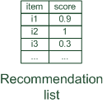

Paradigms of recommender systems
Recommender systems reduce information overload by estimating relevance

Slide 22


Paradigms of recommender systems
Personalized recommendations

Slide 23

Paradigms of recommender systems
Collaborative: "Tell me what's popular among my peers"

Slide 24
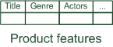
Paradigms of recommender systems
Content-based: "Show me more of the same what I've liked"

Slide 25


Paradigms of recommender systems
Knowledge-based: "Tell me what fits based on my needs"

Slide 26
Paradigms of recommender systems
Hybrid: combinations of various inputs and/or composition of different mechanism

Slide 27


Recommender systems: basic techniques
 | Pros | Cons
Collaborative | No knowledge-engineering effort, serendipity of results, learns market segments | Requires some form of rating feedback, cold start for new users and new items
Content-based | No community required, comparison between items possible | Content descriptions necessary, cold start for new users, no surprises
Knowledge-based | Deterministic recommendations, assured quality, no cold-start, can resemble sales dialogue | Knowledge engineering effort to bootstrap, basically static, does not react to short-term trends

Slide 28
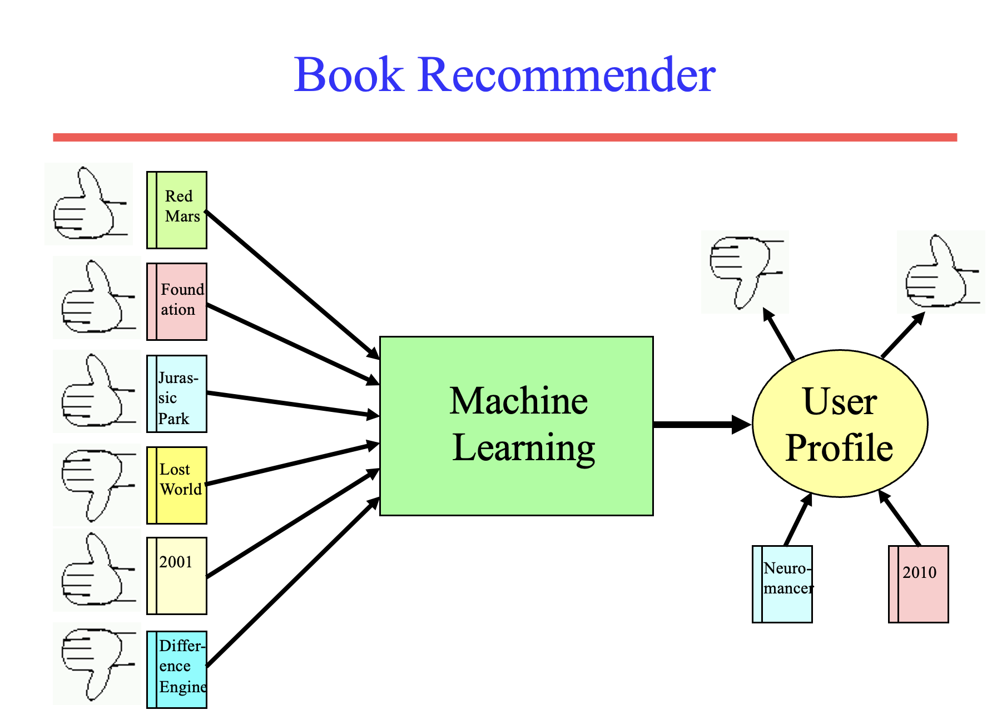

Slide 29
Personalization
Recommenders are instances of personalization software.
Personalization concerns adapting to the individual needs, interests, and preferences of each user.
Includes:
Recommending
Filtering
Predicting (e.g. form or calendar appt. completion)
From a business perspective, it is viewed as part of Customer Relationship Management (CRM).

Slide 30
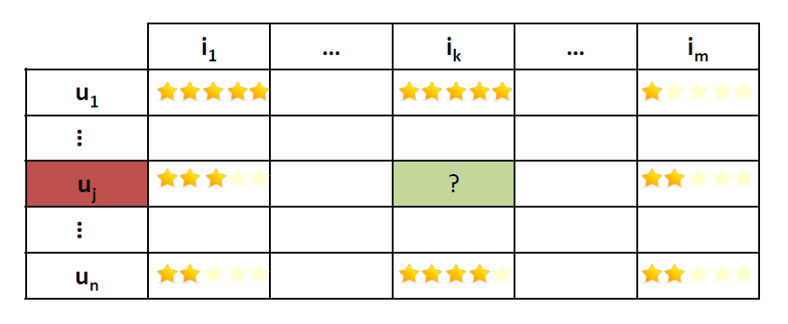
Ratings matrix
Objects (e.g., movies, products)
Users
Sparse matrix: Most values are unknown
Predicting: The task of filling the unknown values

Slide 31
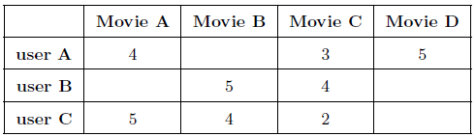
Recommendation Systems
Infer user preferences about items
Produce highly relevant & personalized lists of items
items
rating: level of preference
users
unknown preferences
ratings matrix
Notes:
Τα συστήματα συστάσεων προσπαθούν να συμπεράνουν τις προτιμήσεις των χρηστών, και για τον κάθε χρήστη να παράξουν λίστες με αντικείμενα που έχουν προβλεφθεί ότι θα προτιμούνται ιδιαίτερα. Αξιοποιώντας για παράδειγμα τις βαθμολογίες που έχουν δώσει οι χρήστες για διάφορες ταινίες, προσπαθούμε να προβλέψουμε τις βαθμολογίες που θα έδιναν σε άλλες που δε γνωρίζουμε, και να τους προτείνουμε αυτές που προβλέπουμε με υψηλό σκορ.

Slide 32
Collaborative Filtering

Slide 33
Collaborative Filtering (CF)
The most prominent approach to generate recommendations
used by large, commercial e-commerce sites
well-understood, various algorithms and variations exist
applicable in many domains (book, movies, DVDs, ..)
Approach
use the "wisdom of the crowd" to recommend items
Basic assumption and idea
Users give ratings to catalog items (implicitly or explicitly)
Customers who had similar tastes in the past, will have similar tastes in the future

Slide 34
1992: Using collaborative filtering to weave an information tapestry, D. Goldberg et al., Communications of the ACM
Basic idea: "Eager readers read all docs immediately, casual readers wait for the eager readers to annotate"
Experimental mail system at Xerox Parc that records reactions of users when reading a mail
Users are provided with personalized mailing list filters instead of being forced to subscribe
Content-based filters (topics, from/to/subject…)
Collaborative filters
E.g. Mails to [all] which were replied by [John Doe] and which received positive ratings from [X] and [Y].

Slide 35
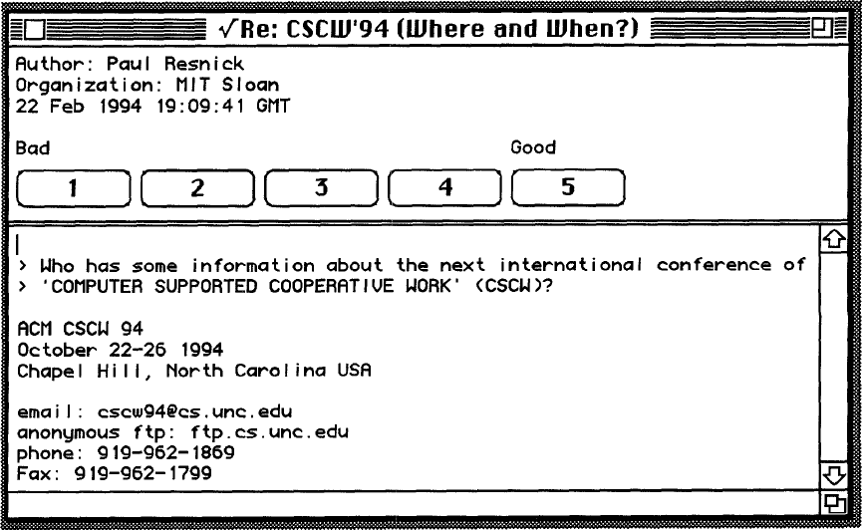
1994: GroupLens: an open architecture for collaborative filtering of netnews, P. Resnick et al., ACM CSCW
Tapestry system does not aggregate ratings and requires knowing each other
Basic idea: "People who agreed in their subjective evaluations in the past are likely to agree again in the future"
Builds on newsgroup browsers with rating functionality

Slide 36
User-based nearest-neighbor collaborative filtering (1)
The basic technique:
Given an "active user" (Alice) and an item I not yet seen by Alice
The goal is to estimate Alice's rating for this item, e.g., by
find a set of users (peers) who liked the same items as Alice in the past and who have rated item I
use, e.g. the average of their ratings to predict, if Alice will like item I
do this for all items Alice has not seen and recommend the best-rated
 | Item1 | Item2 | Item3 | Item4 | Item5
Alice | 5 | 3 | 4 | 4 | ?
User1 | 3 | 1 | 2 | 3 | 3
User2 | 4 | 3 | 4 | 3 | 5
User3 | 3 | 3 | 1 | 5 | 4
User4 | 1 | 5 | 5 | 2 | 1

Slide 37
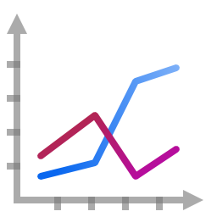
User-based nearest-neighbor collaborative filtering (2)
Some first questions
How do we measure similarity?
How many neighbors should we consider?
How do we generate a prediction from the neighbors' ratings?
 | Item1 | Item2 | Item3 | Item4 | Item5
Alice | 5 | 3 | 4 | 4 | ?
User1 | 3 | 1 | 2 | 3 | 3
User2 | 4 | 3 | 4 | 3 | 5
User3 | 3 | 3 | 1 | 5 | 4
User4 | 1 | 5 | 5 | 2 | 1

Slide 38
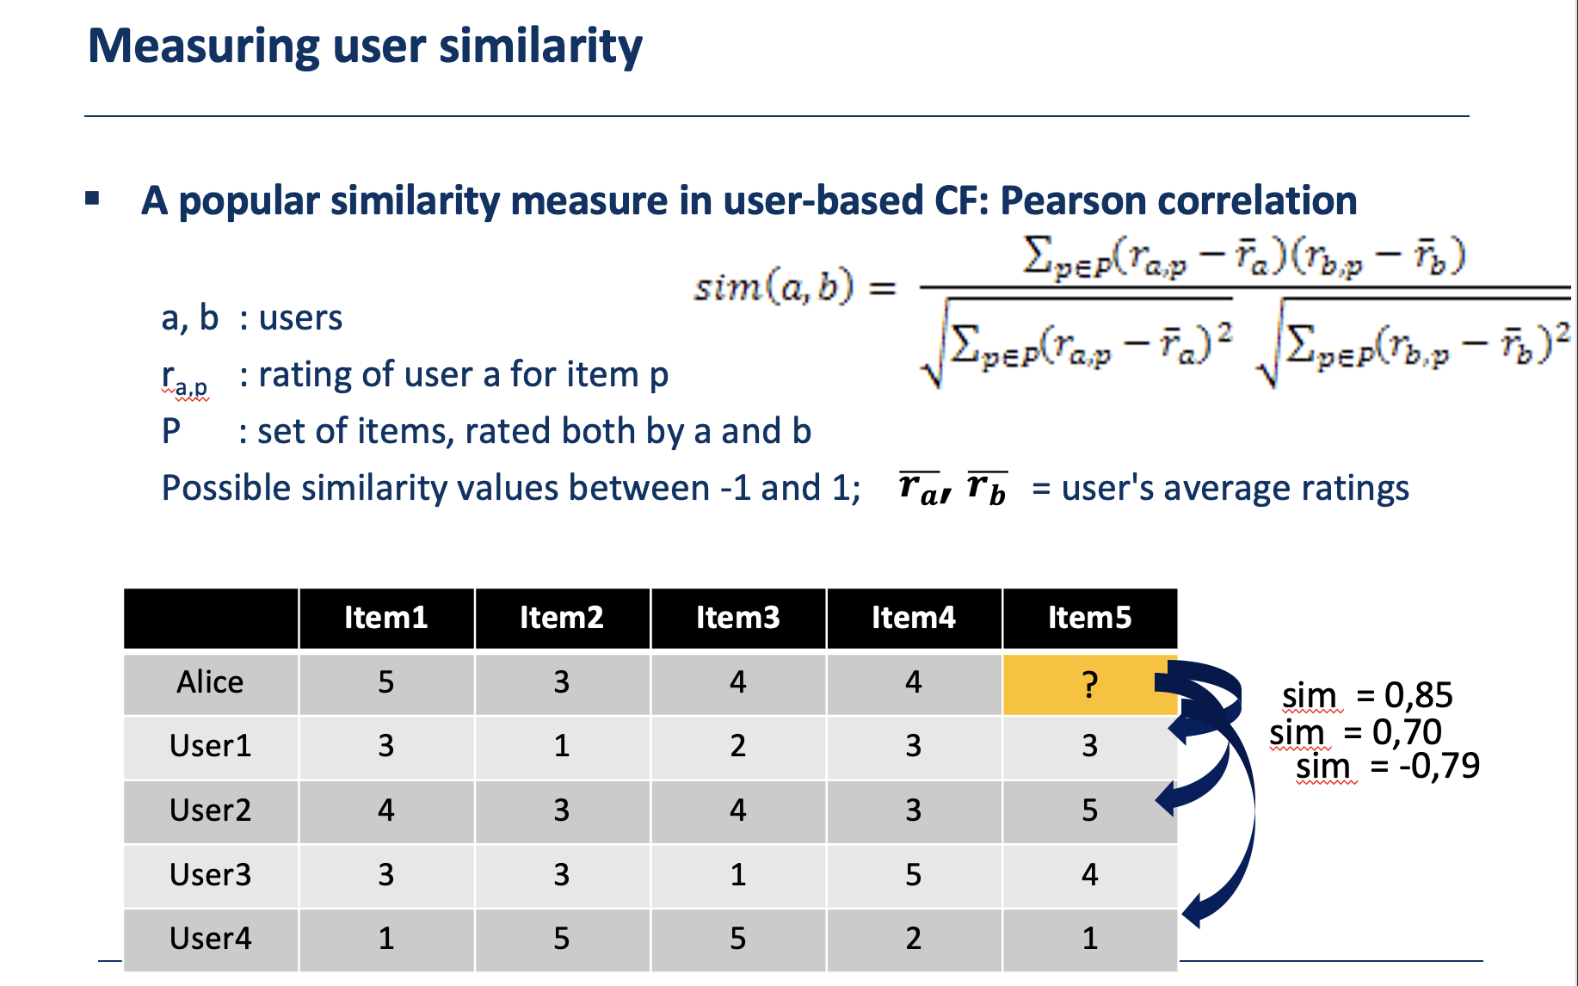
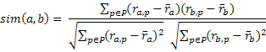
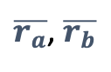
Measuring user similarity
A popular similarity measure in user-based CF: Pearson correlation
a, b : users
r_{a,p} : rating of user a for item p
P : set of items, rated both by a and b
Possible similarity values between -1 and 1; = user's average ratings
$\overline{r_{a}}$, $\overline{r_{b}}$
 | Item1 | Item2 | Item3 | Item4 | Item5
Alice | 5 | 3 | 4 | 4 | ?
User1 | 3 | 1 | 2 | 3 | 3
User2 | 4 | 3 | 4 | 3 | 5
User3 | 3 | 3 | 1 | 5 | 4
User4 | 1 | 5 | 5 | 2 | 1
sim = 0,85
sim = 0,70
sim = -0,79

Slide 39
Pearson correlation
Takes differences in rating behavior into account
Works well in usual domains, compared with alternative measures
such as cosine similarity

Slide 40

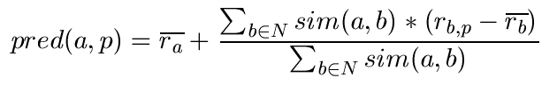
Making predictions
A common prediction function:
Calculate, whether the neighbors' ratings for the unseen item i are higher or lower than their average
Combine the rating differences – use the similarity as a weight
Add/subtract the neighbors' bias from the active user's average and use this as a prediction

Slide 41
The bias of a user is the difference between their average rating and the average rating of all users.
It is used to adjust the predicted rating to account for the fact that some users are more generous or more critical raters than others.

Slide 42
Making recommendations
Making predictions is typically not the ultimate goal
Usual approach (in academia)
Rank items based on their predicted ratings
However
This might lead to the inclusion of (only) niche items
In practice also: Take item popularity into account
Approaches
"Learning to rank"
Optimize according to a given rank evaluation metric (see later)

Slide 43
Improving the metrics / prediction function
Not all neighbor ratings might be equally "valuable"
Agreement on commonly liked items is not so informative as agreement on controversial items
Possible solution: Give more weight to items that have a higher variance
Value of number of co-rated items
Use "significance weighting", by e.g., linearly reducing the weight when the number of co-rated items is low
Case amplification
Intuition: Give more weight to "very similar" neighbors, i.e., where the similarity value is close to 1.
Neighborhood selection
Use similarity threshold or fixed number of neighbors

Slide 44
Memory-based and model-based approaches
User-based CF is said to be "memory-based"
the rating matrix is directly used to find neighbors / make predictions
does not scale for most real-world scenarios
large e-commerce sites have tens of millions of customers and millions of items
Model-based approaches
based on an offline pre-processing or "model-learning" phase
at run-time, only the learned model is used to make predictions
models are updated / re-trained periodically
large variety of techniques used
model-building and updating can be computationally expensive

Slide 45
2001: Item-based collaborative filtering recommendation algorithms, B. Sarwar et al., WWW 2001
Scalability issues arise with U2U if many more users than items (m >> n , m = |users|, n = |items|)
e.g. Amazon.com
Space complexity O(m²) when pre-computed
Time complexity for computing Pearson O(m²n)
High sparsity leads to few common ratings between two users
Basic idea: "Item-based CF exploits relationships between items first, instead of relationships between users"

Slide 46
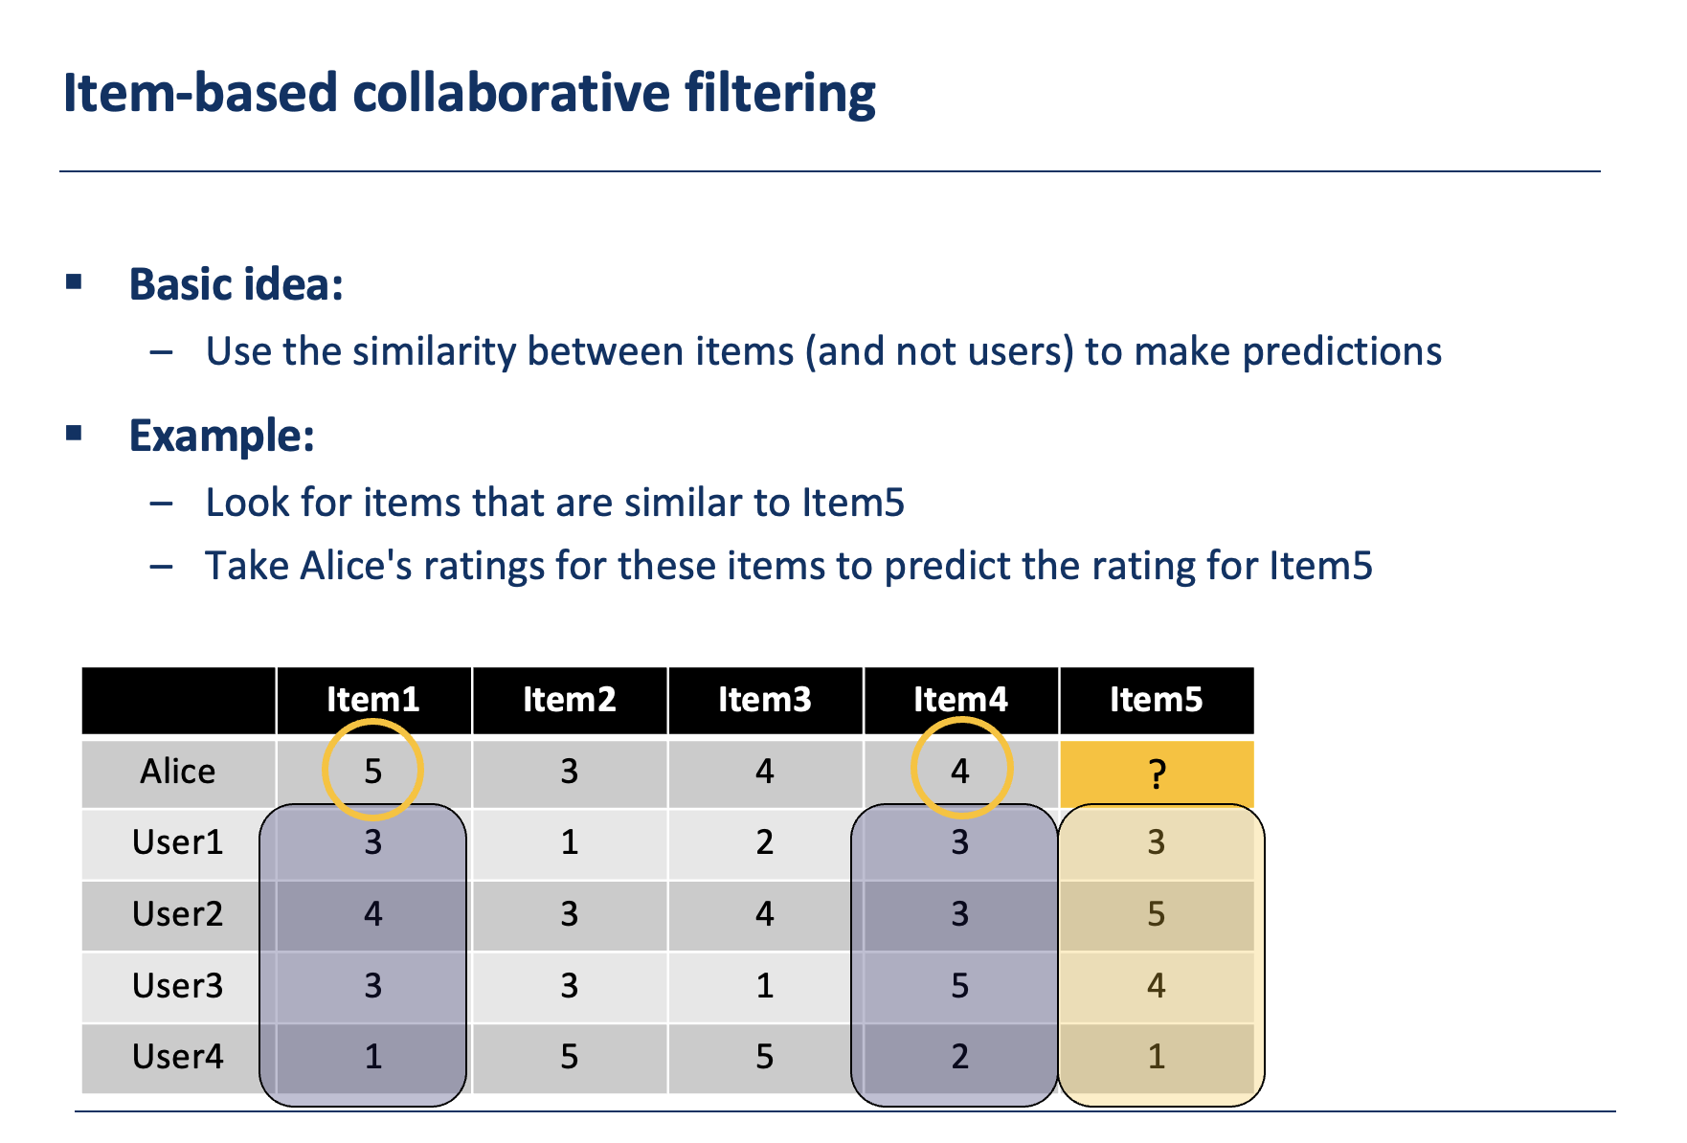
Item-based collaborative filtering
Basic idea:
Use the similarity between items (and not users) to make predictions
Example:
Look for items that are similar to Item5
Take Alice's ratings for these items to predict the rating for Item5
 | Item1 | Item2 | Item3 | Item4 | Item5
Alice | 5 | 3 | 4 | 4 | ?
User1 | 3 | 1 | 2 | 3 | 3
User2 | 4 | 3 | 4 | 3 | 5
User3 | 3 | 3 | 1 | 5 | 4
User4 | 1 | 5 | 5 | 2 | 1

Slide 47
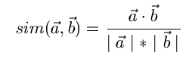
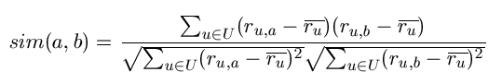
The cosine similarity measure
Produces better results in item-to-item filtering
for some datasets, no consistent picture in literature
Ratings are seen as vector in n-dimensional space
Similarity is calculated based on the angle between the vectors
Adjusted cosine similarity
take average user ratings into account, transform the original ratings
U: set of users who have rated both items a and b

Slide 48
Pre-processing for item-based filtering
Item-based filtering does not solve the scalability problem itself
Pre-processing approach by Amazon.com (in 2003)
Calculate all pair-wise item similarities in advance
The neighborhood to be used at run-time is typically rather small, because only items are taken into account which the user has rated
Item similarities are supposed to be more stable than user similarities
Memory requirements
Up to N² pair-wise similarities to be memorized (N = number of items) in theory
In practice, this is significantly lower (items with no co-ratings)
Further reductions possible
Minimum threshold for co-ratings (items, which are rated at least by n users)
Limit the size of the neighborhood (might affect recommendation accuracy)

Slide 49
More on ratings
Pure CF-based systems only rely on the rating matrix
Explicit ratings
Most commonly used (1 to 5, 1 to 7 Likert response scales)
Research topics
"Optimal" granularity of scale; indication that 10-point scale is better accepted in movie domain
Multidimensional ratings (multiple ratings per movie)
Challenge
Users not always willing to rate many items; sparse rating matrices
How to stimulate users to rate more items?
Implicit ratings
clicks, page views, time spent on some page, demo downloads …
Can be used in addition to explicit ones; question of correctness of interpretation

Slide 50
Data sparsity problems
Cold start problem
How to recommend new items? What to recommend to new users?
Straightforward approaches
Ask/force users to rate a set of items
Use another method (e.g., content-based, demographic or simply non-personalized) in the initial phase
Alternatives
Use better algorithms (beyond nearest-neighbor approaches)
Example:
In nearest-neighbor approaches, the set of sufficiently similar neighbors might be to small to make good predictions
Assume "transitivity" of neighborhoods

Slide 51
Example algorithms for sparse datasets
Recursive CF
Assume there is a very close neighbor n of u who however has not rated the target item i yet.
Idea:
Apply CF-method recursively and predict a rating for item i for the neighbor
Use this predicted rating instead of the rating of a more distant direct neighbor
 | Item1 | Item2 | Item3 | Item4 | Item5
Alice | 5 | 3 | 4 | 4 | ?
User1 | 3 | 1 | 2 | 3 | ?
User2 | 4 | 3 | 4 | 3 | 5
User3 | 3 | 3 | 1 | 5 | 4
User4 | 1 | 5 | 5 | 2 | 1
sim = 0,85
Predict rating for
User1

Slide 52
More model-based approaches
Plethora of different techniques proposed in the last years, e.g.,
Matrix factorization techniques, statistics
singular value decomposition, principal component analysis
Association rule mining
compare: shopping basket analysis
Probabilistic models
clustering models, Bayesian networks, probabilistic Latent Semantic Analysis
Various other machine learning approaches
Costs of pre-processing
Usually not discussed
Incremental updates possible?

Slide 53
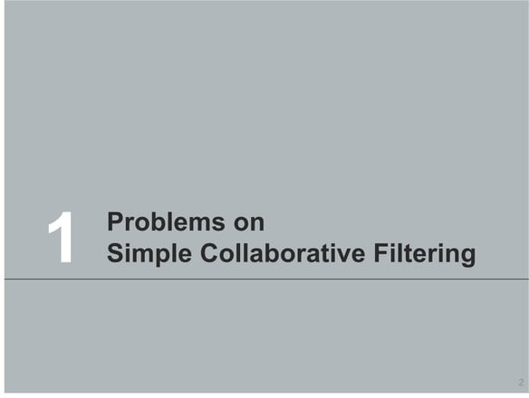

Slide 54
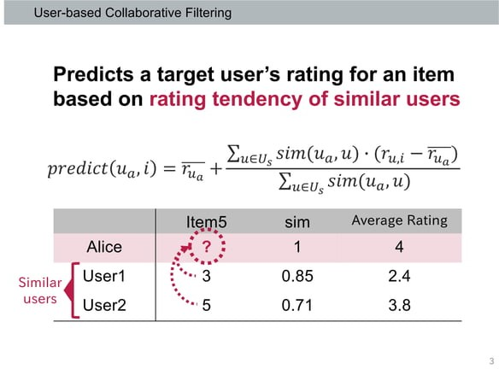

Slide 55
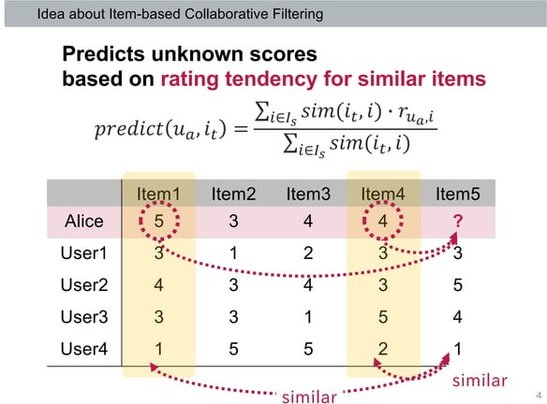

Slide 56
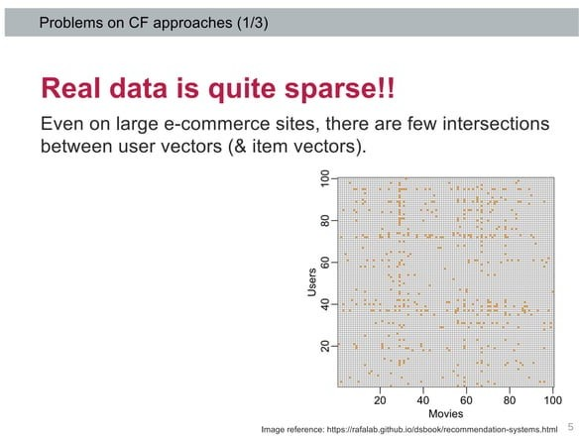

Slide 57
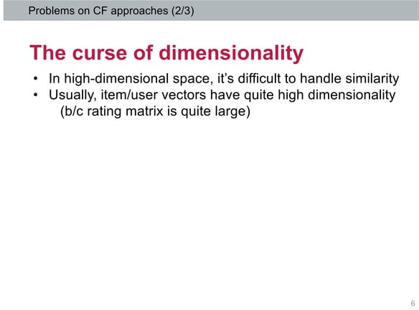

Slide 58
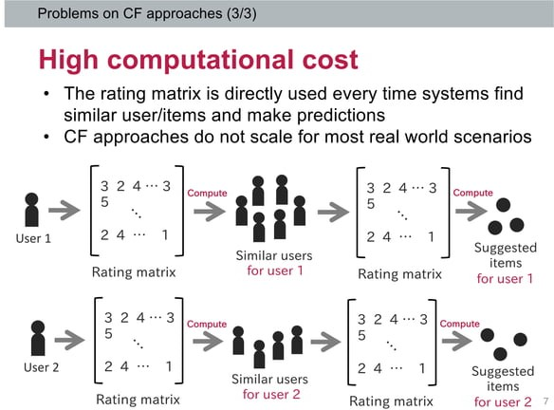

Slide 59
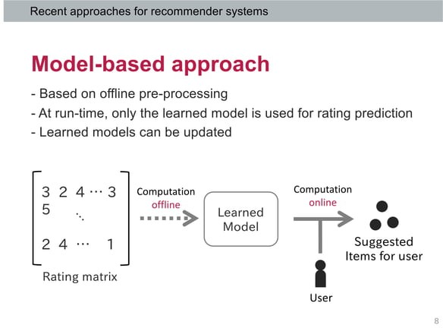

Slide 60
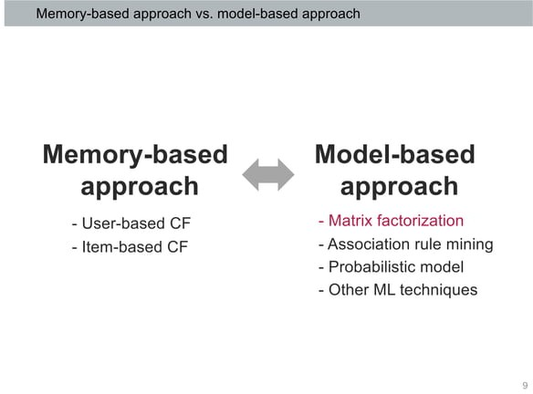

Slide 61
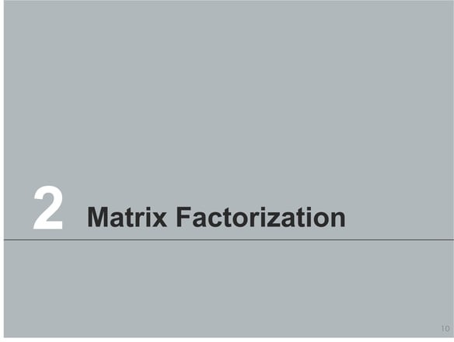

Slide 62
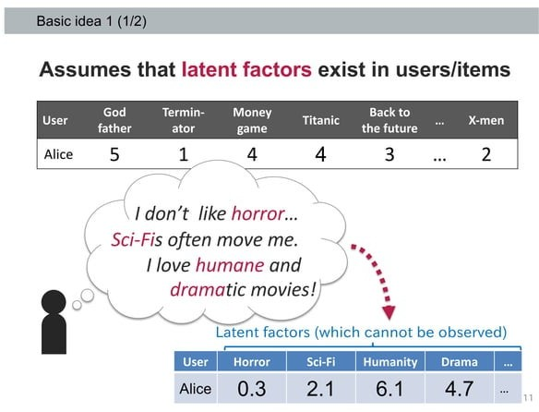

Slide 63
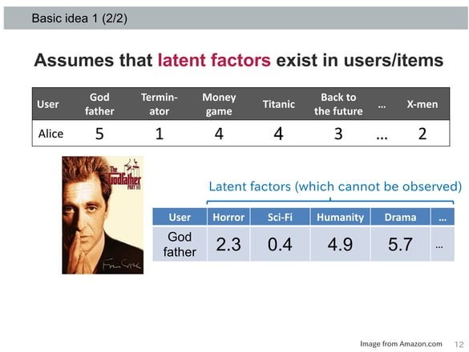

Slide 64
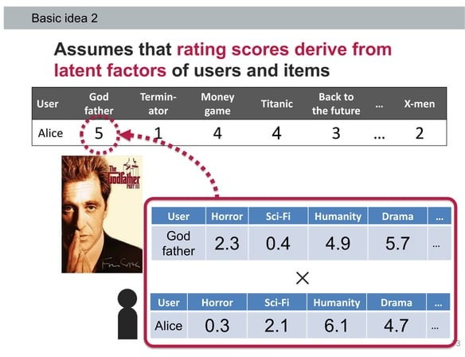

Slide 65


Slide 66


Slide 67


Slide 68


Slide 69


Slide 70


Slide 71


Slide 72


Slide 73


Slide 74


Slide 75


Slide 76


Slide 77


Slide 78


Slide 79


Slide 80
Association rule mining
Commonly used for shopping behavior analysis
aims at detection of rules such as
"If a customer purchases baby-food then he also buys diapers in 70% of the cases”
Association rule mining algorithms
can detect rules of the form X => Y (e.g., baby-food => diapers) from a set of sales transactions D = {t₁, t₂, … t_{n}}
measure of quality: support, confidence

Slide 81
Probabilistic methods
Basic idea (simplistic version for illustration):
given the user/item rating matrix
determine the probability that user Alice will like an item i
base the recommendation on such these probabilities
Calculation of rating probabilities based on Bayes Theorem
How probable is rating value "1" for Item5 given Alice's previous ratings?
Corresponds to conditional probability P(Item5=1 | X), where
X = Alice's previous ratings = (Item1 =1, Item2=3, Item3= … )
Can be estimated based on Bayes' Theorem
Usually more sophisticated methods used
Clustering
pLSA …

Slide 82
Collaborative Filtering Issues
Pros:
well-understood, works well in some domains, no knowledge engineering required
Cons:
requires user community, sparsity problems, no integration of other knowledge sources, no explanation of results
What is the best CF method?
In which situation and which domain? Inconsistent findings; always the same domains and data sets; differences between methods are often very small (1/100)

Slide 83
Content-based recommendation

Slide 84
Content-based recommendation
Collaborative filtering does NOT require any information about the items,
However, it might be reasonable to exploit such information
E.g. recommend fantasy novels to people who liked fantasy novels in the past
What do we need:
Some information about the available items such as the genre ("content")
Some sort of user profile describing what the user likes (the preferences)
The task:
Learn user preferences
Locate/recommend items that are "similar" to the user preferences

Slide 85


Slide 86
What is the "content"?
The genre is actually not part of the content of a book
Most CB-recommendation methods originate from Information Retrieval (IR) field:
The item descriptions are usually automatically extracted (important words)
Goal is to find and rank interesting text documents (news articles, web pages)
Here:
Classical IR-based methods based on keywords
No expert recommendation knowledge involved
User profile (preferences) are rather learned than explicitly elicited

Slide 87


Slide 88


Slide 89
Term-Frequency - Inverse Document Frequency (TF-IDF)
Simple keyword representation has its problems
In particular when automatically extracted because
Not every word has similar importance
Longer documents have a higher chance to have an overlap with the user profile
Standard measure: TF-IDF
Encodes text documents as weighted term vector
TF: Measures, how often a term appears (density in a document)
Assuming that important terms appear more often
Normalization has to be done in order to take document length into account
IDF: Aims to reduce the weight of terms that appear in all documents

Slide 90

TF-IDF
Compute the overall importance of keywords
Given a keyword i and a document j
TF-IDF (i,j) = TF(i,j) * IDF(i)
Term frequency (TF)
Let freq(i,j) number of occurrences of keyword i in document j
Let maxOthers(i,j) denote the highest number of occurrences of another keyword of j
$TF\left(i,j\right)= \frac{freq(i,j)}{maxOthers(i,j)}$
Inverse Document Frequency (IDF)
N: number of all recommendable documents
n(i): number of documents in which keyword i appears
$IDF(i)=log\frac{N}{n(i)}$

Slide 91

Example TF-IDF representation
Figure taken from http://informationretrieval.org

Slide 92
More on the vector space model
Vectors are usually long and sparse
Improvements
Remove stop words ("a", "the", ..)
Use stemming
Size cut-offs (only use top n most representative words, e.g. around 100)
Use additional knowledge, use more elaborate methods for feature selection
Detection of phrases as terms (such as United Nations)
Limitations
Semantic meaning remains unknown
Example: usage of a word in a negative context
"there is nothing on the menu that a vegetarian would like.."
Usual similarity metric to compare vectors: Cosine similarity (angle)

Slide 93


Slide 94
Recommending items
Simple method: nearest neighbors
Given a set of documents D already rated by the user (like/dislike)
Find the n nearest neighbors of a not-yet-seen item i in D
Take these ratings to predict a rating/vote for i
(Variations: neighborhood size, lower/upper similarity thresholds)
Query-based retrieval: Rocchio's method
The SMART System: Users are allowed to rate (relevant/irrelevant) retrieved documents (feedback)
The system then learns a prototype of relevant/irrelevant documents
Queries are then automatically extended with additional terms/weight of relevant documents

Slide 95


Slide 96


Slide 97
Improvements
Side note: Conditional independence of events does in fact not hold
“New”/ “York“ and “Hong” / “Kong"
Still, good accuracy can be achieved
Boolean representation simplistic
Keyword counts
More elaborate probabilistic methods
E.g. estimate probability of term v occurring in a document of class C by relative frequency of v in all documents of the class
Other linear classification algorithms (machine learning) can be used
Support Vector Machines, ..

Slide 98
Limitations of content-based recommendation methods
Keywords alone may not be sufficient to judge quality/relevance of a document or web page
Up-to-dateness, usability, aesthetics, writing style
Content may also be limited / too short
Content may not be automatically extractable (multimedia)
Ramp-up phase required
Some training data is still required
Web 2.0: Use other sources to learn the user preferences
Overspecialization
Algorithms tend to propose "more of the same"
E.g. too similar news items

